Slide 1
चरैवेति, चरैवेति
Keep progressing to attain a higher self.
avinash.bhagat@lpu.co.in Avinash Bhagat 9463281930

Slide 2
CAP256: Computer Networks
Lecture 24-28
Routing Protocols
avinash.bhagat@lpu.co.in Avinash Bhagat 9463281930

Slide 3
Objectives
Understand Routing
Static and Dynamic Routing
Routing Algorithms
Distance Vector Routing.
Link State Routing
Dijkstra Algorithm.

Slide 4
Routing
Routing is the act of moving information across an inter-network from a source to a destination.
It’s also referred to as the process of choosing a path over which to send the packets.
The routing algorithm is the part of the network layer software responsible for deciding which output line an incoming packet should be transmitted on, i.e. what should be the next intermediate node for the packet.

Slide 5
Routing
A router is a device that determines the next network point to which a packet should be forwarded toward its destination.
Allow different networks to communicate with each other
A router creates and maintain a table of the available routes and their conditions and uses this information to determine the best route for a given packet.

Slide 6
Routing
A packet will travel through a number of network points with routers before arriving at its destination.
Allow different networks to communicate with each other
There can be multiple routes defined. The route with a lower weight/metric will be tried first.

Slide 7
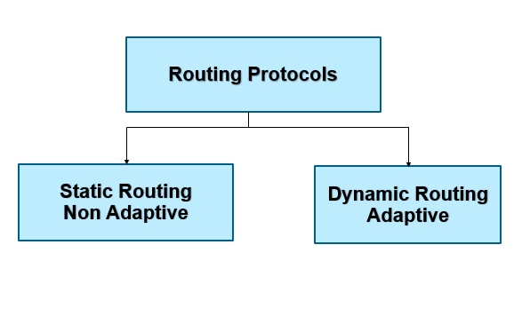
Classification of Routing
Static Routing
Dynamic Routing
Default Routing
Notes:
A router can learn about remote networks in one of two ways:
Manually - Remote networks are manually entered into the route table using static routes.
Dynamically - Remote networks are automatically learned using a dynamic routing protocol.
Each routing protocol can have chapters or even whole books written about then. Most of them have one or more RFCs dedicated to them.

Slide 8
Classification of Routing
Static Routing
This is the method by which an administrator manually adds routes to the routing table of a router. This is a method for small networks but it is not scalable for larger networks.

Slide 9
Classification of Routing
Dynamic Routing
This is the method where protocols and algorithms are used to automatically propagate routing information. This is the most common method and most complex method of routing.

Slide 10
Classification of routing.
Default Routing
This is the method where all routers are configured to send all packets towards a single router.
This is a very useful method for small networks or for networks with a single entry and exit point.
It is usually used in addition to Static and/or Dynamic routing.

Slide 11
Classification of Routing
IGP (Interior Gateway Protocol): Route data within an Autonomous System
EGP (Exterior Gateway Protocol): Route data between Autonomous Systems

Slide 12
Static Routing
A static route is created, maintained, and updated by a network administrator, manually.
A static route to every network must be configured on every router for full connectivity

Slide 13
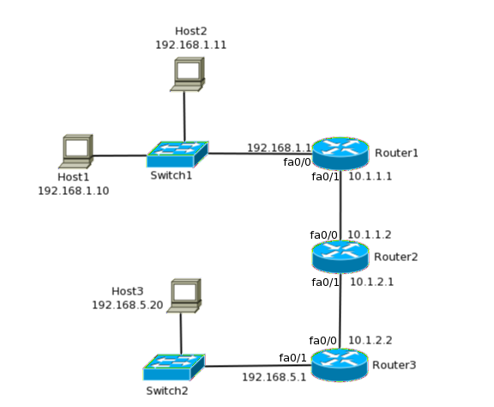
Static Routing

Slide 14
Static Routing
Advantages are:
  There is no overhead in terms of CPU usage of the router as well as bandwidth between routers.
  When dynamic routing is used, packets are exchanged between routers and that uses bandwidth. That can be costly when they traverse across WAN links. The routers also need to process these packets and that consumes some CPU cycles as well.
  It adds a certain degree of security since the administrator controls which routes the routers can know and learn.
  Secure networks as only administrator knows the path.

Slide 15
Static Routing
The disadvantages of static routing are:
The administrator needs to know the internetwork so well that he/she knows where each destination network lies and which is the next hop towards it.
Every change needs to be manually done on each router in the internetwork.
In large networks this can be unmanageable.

Slide 16
Default Routing
Default routing can be considered a special type of static routing.
The difference between a normal static route and a default route is that a default route is used to send packets destined to any unknown destination to a single next hop address.

Slide 17
Default Routing
To understand how this works, consider Router1, without any static routes in it.
When it receives a packet destined to 192.168.5.0/24 it will drop it since it does not know where the destination network is.
If a default route is added in Router1 with next hop address of Router2, all packets destined to any unknown destination, such as 192.168.5.0/24 will be sent to Router2.

Slide 18
Dynamic Routing
Dynamic routing is when protocols, called routing protocols, are used to build the routing tables across the network.
Using a routing protocol is easier than static routing and default routing, but it is more expensive in terms of CPU and bandwidth usage.
Every routing protocol defines its own rules for communication between routers and selecting the best route.

Slide 19
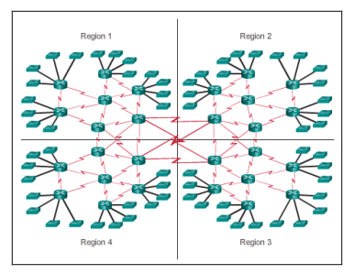
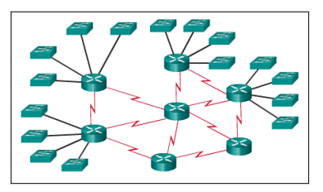
Dynamic Routing

Slide 20
Dynamic Routing
Advantages of Dynamic Routing
Suitable in all topologies where multiple routers are required.
Generally independent of the network size.
Automatically adapts topology to reroute traffic if possible.
Generally independent of the network size.

Slide 21
Dynamic Routing
Disadvantages of Dynamic Routing
Can be more complex to initially implement.
Less secure due to the broadcast and multicast routing updates. Additional configuration settings such as passive interfaces and routing protocol authentication are required to increase security.
Requires additional resources such as CPU, memory, and link bandwidth

Slide 22
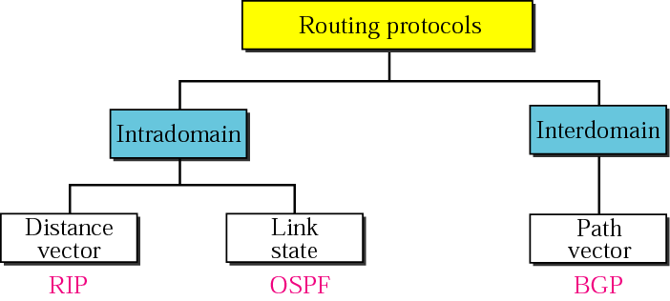
Routing Protocols

Slide 23
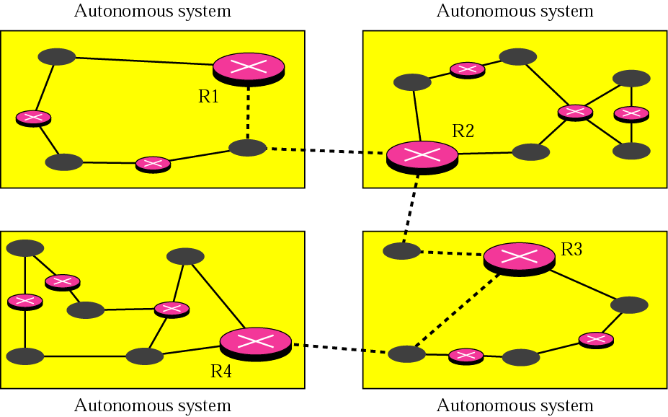
Routing Protocols

Slide 24
Dynamic Routing
IGP (Interior Gateway Protocol): Route data within an Autonomous System
    RIP (Routing Information Protocol)
    RIP-2 (RIP Version 2)
    OSPF (Open Shortest Path First)
    IGRP (Interior Gateway Routing Protocol)
    EIGRP (Enhanced Interior Gateway Routing Protocol)
EGP (Exterior Gateway Protocol): Route data between Autonomous Systems
    BGP (Border Gateway Protocol)

Slide 25
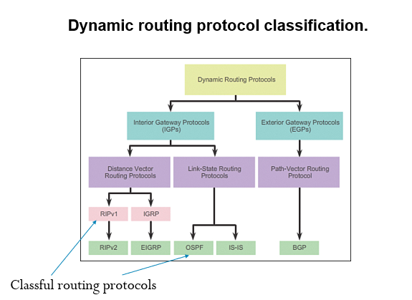
Dynamic Routing
Notes:
A router can learn about remote networks in one of two ways:
Manually - Remote networks are manually entered into the route table using static routes.
Dynamically - Remote networks are automatically learned using a dynamic routing protocol.
Each routing protocol can have chapters or even whole books written about then. Most of them have one or more RFCs dedicated to them.

Slide 26
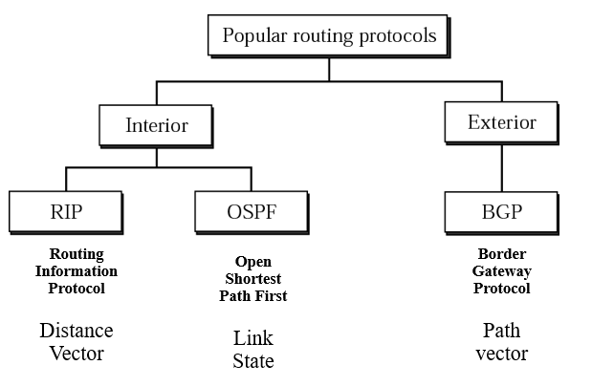
Routing
Notes:
A router can learn about remote networks in one of two ways:
Manually - Remote networks are manually entered into the route table using static routes.
Dynamically - Remote networks are automatically learned using a dynamic routing protocol.
Each routing protocol can have chapters or even whole books written about then. Most of them have one or more RFCs dedicated to them.

Slide 27
Routing Algorithm
A routing algorithm is a procedure that lays down the route or path to transfer data packets from source to the destination.
They help in directing Internet traffic efficiently.
After a data packet leaves its source, it can choose among the many different paths to reach its destination.
Routing algorithm mathematically computes the best path, i.e. “least – cost path” that the packet can be routed through.

Slide 28
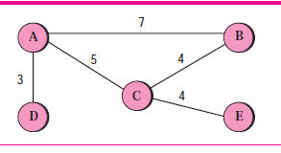
Distance Vector Routing
We first discuss distance vector routing. This method sees an AS Autonomous Station, with all routers and networks, as a graph, a set of nodes and lines (edges) connecting the nodes.
A router can normally be represented by a node and a network by a link connecting two nodes, although other representations are also possible.

Slide 29
Distance Vector Routing
The graph theory used an algorithm called Bellman-Ford to find the shortest path between nodes in a graph given the distance between nodes.
If we know the cost between each pair of nodes, we can use the algorithm to find the least cost (shortest path) between any two nodes.

Slide 30
Distance Vector Routing
We can use the algorithm for creating the routing table for routers in an AS, we need to change the algorithm:
In distance vector routing, the cost is normally hop counts (how many networks are passed before reaching the destination). So the cost between any two neighbours is set to 1.
2. Each router needs to update its routing table asynchronously, whenever it has received some information from its neighbours. In other words, each router executes part of the whole algorithm in the Bellman-Ford algorithm.

Slide 31
Distance Vector Routing
3. After a router has updated its routing table, it should send the result to its neighbours so that they can also update their routing table.
4. Each router should keep at least three pieces of information for each route:
  destination network, the cost, and the next hop.
Tablei.dest, Tablei.cost, and Tablei.next.
5. We refer to information about each route received from a neighbour as R (record), which has only two pieces of information: R.dest and R.cost. The next hop is not included in the received record because it is the source address of the sender.

Slide 32
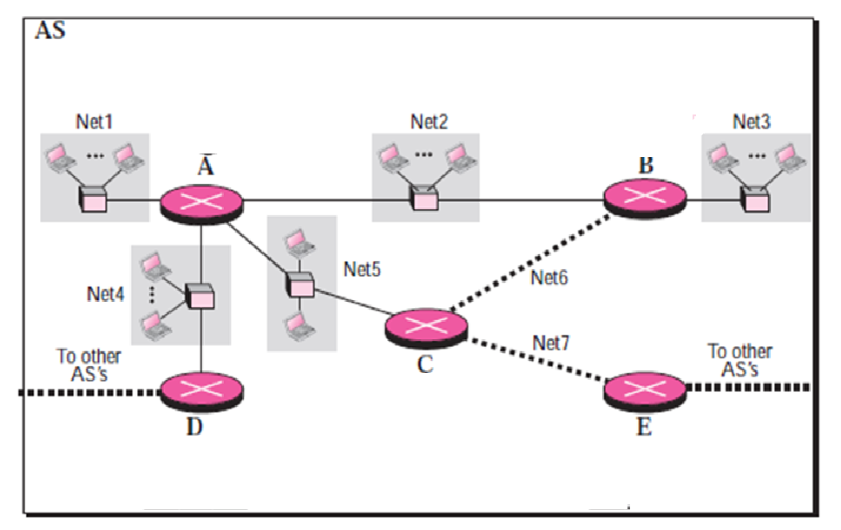

Slide 33
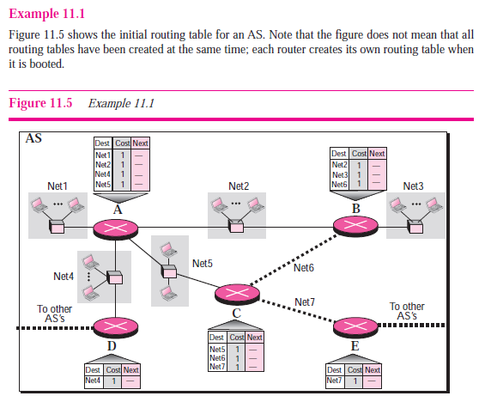

Slide 34

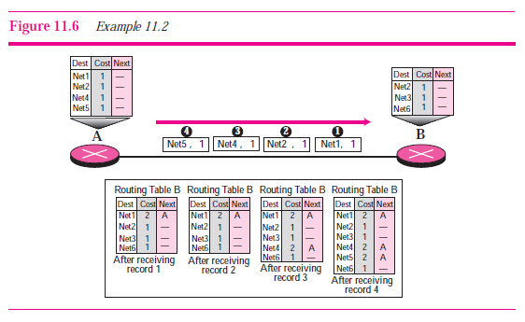

Slide 35
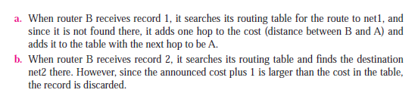

Slide 36


Slide 37
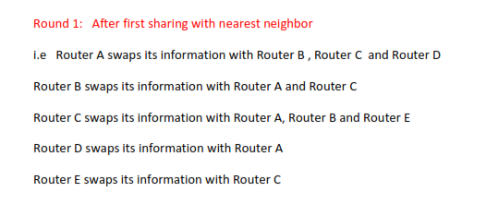
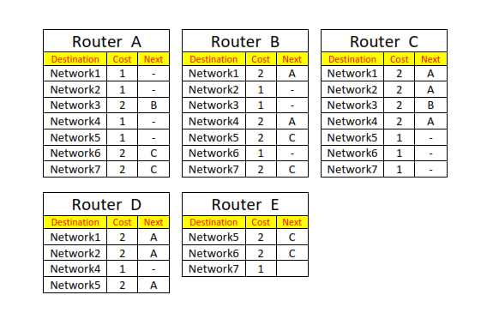

Slide 38
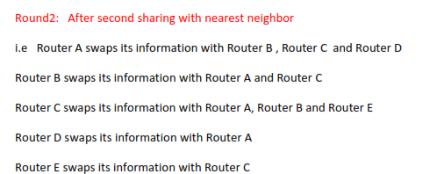
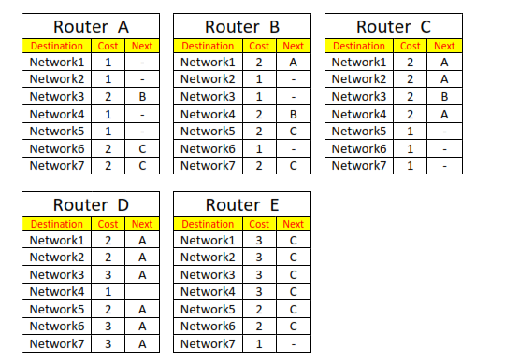

Slide 39
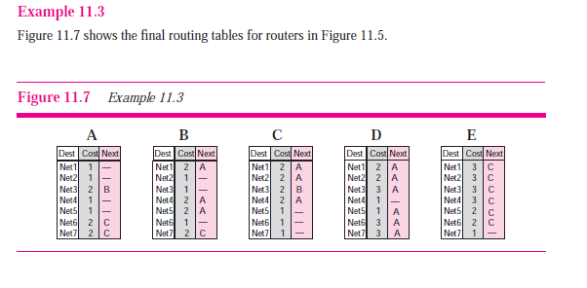

Slide 42
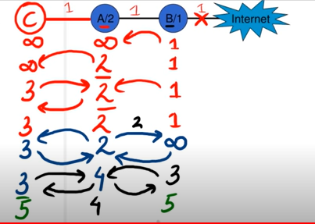
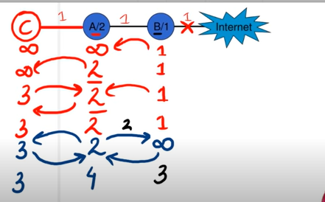
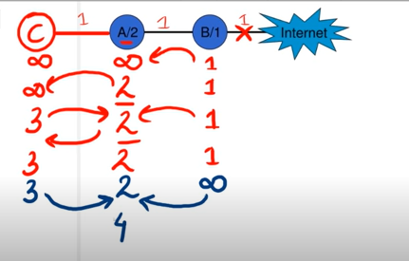
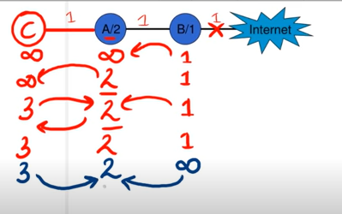
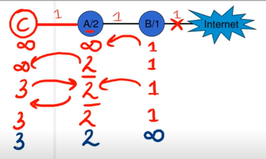
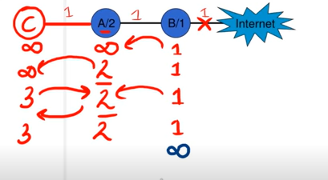
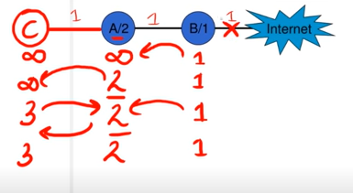


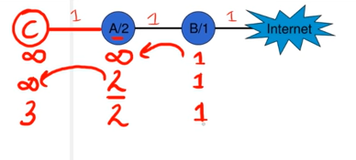
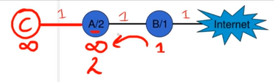
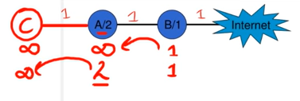
Count to infinity problem in distance vector routing.
Notes:
Moving from nodes A B and C to internet.

Slide 43
Link-State Routing
Link state routing protocols
  -Also known as shortest path first algorithms
-These protocols built around Dijkstra’s algorithm

Slide 44
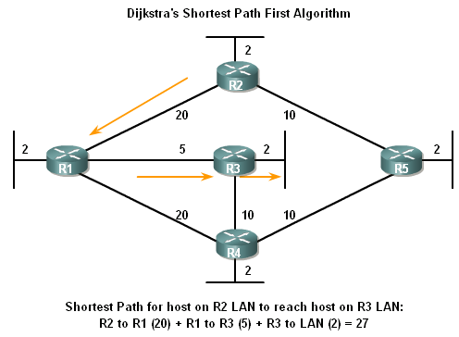
Link-State Routing
Dikjstra’s algorithm also known as the shortest path first (SPF) algorithm

Slide 45
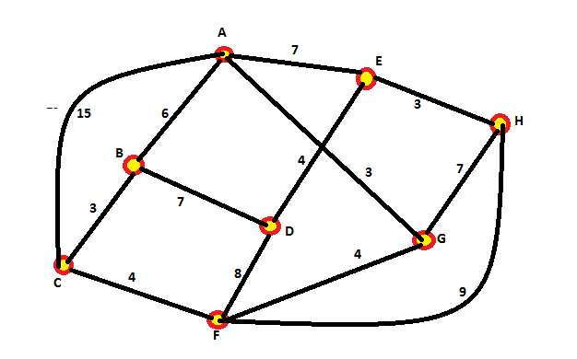
Link-State Routing
Question: In the given network find the shortest distance from node A to node H using Dijkstra algorithm / OSPF
-

Slide 46
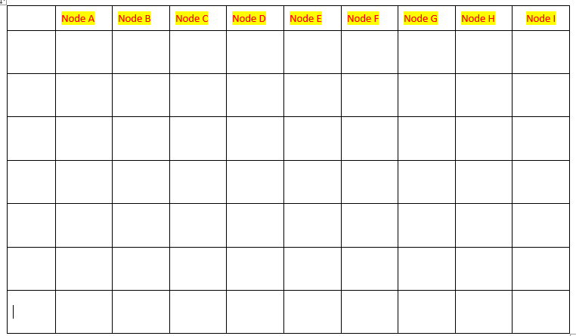

Slide 47
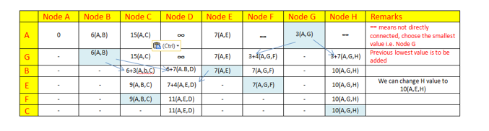

Slide 48
Link-State Routing Process
How routers using Link State Routing Protocols reach convergence
    -Each routers learns about its own directly connected networks
    -Link state routers exchange hello packet to “meet” other directly connected link state routers.
    -Each router builds its own Link State Packet (LSP) which includes information about neighbors such as neighbor ID, link type, & bandwidth.

Slide 49
Link-State Routing Process
    -After the LSP is created the router floods it to all neighbors who then store the information and then forward it until all routers have the same information.
    -Once all the routers have received all the LSPs, the routers then construct a topological map of the network which is used to determine the best routes to a destination

Slide 50
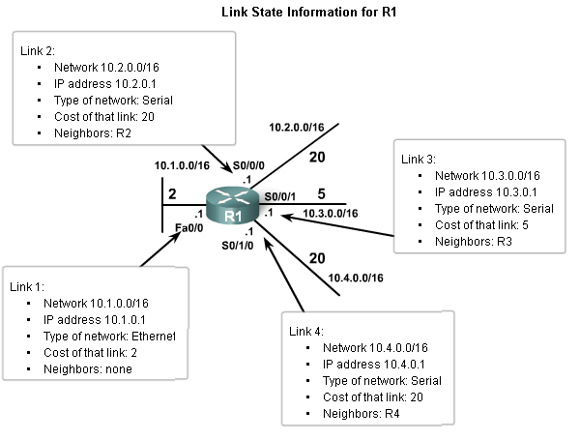
Link-State Routing
Directly Connected Networks
Link
This is an interface on
a router
Link state
This is the information about the state of the links

Slide 51
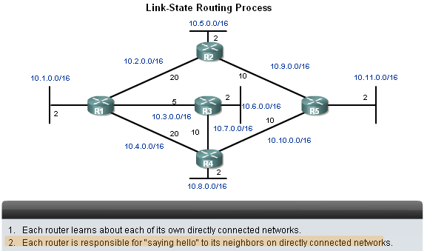
Link-State Routing
Sending Hello Packets to Neighbors
Link state routing protocols use a hello protocol
-To discover neighbors (that use the same link state routing protocol) on its link

Slide 52
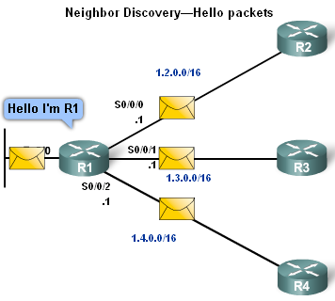
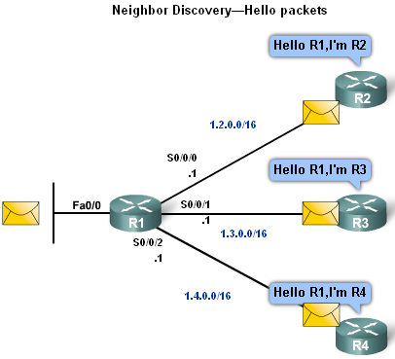
Link-State Routing
Sending Hello Packets to Neighbors
Connected interfaces that are using the same link state routing protocols will exchange hello packets.
Once routers learn it has neighbors they form an adjacency and adjacent neighbors will exchange hello packets
These packets will serve as a keep alive function

Slide 53

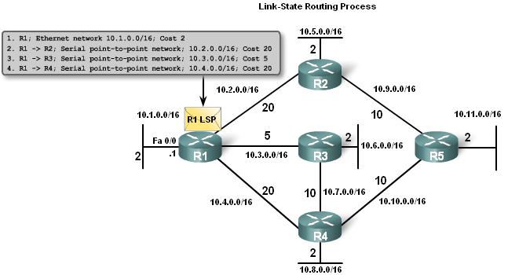
Link-State Routing
Building the Link State Packet
Each router builds its own Link State Packet (LSP)
Contents of LSP:
State of each directly connected link Includes
information about neighbors such as
  neighbor ID,
  link type,
  & bandwidth.

Slide 54
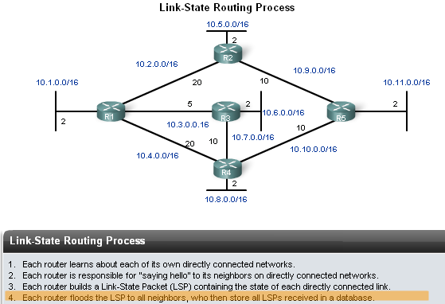
Link-State Routing
Flooding LSPs to Neighbors
Once LSP are created they are forwarded out to neighbors.
  -After receiving the LSP the neighbor continues to forward it throughout routing area.

Slide 55
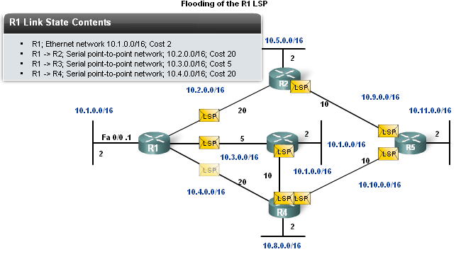
Link-State Routing
LSPs are sent out under the following conditions
-Initial router start up or routing process
-When there is a change in topology

Slide 56
Summary
Link State Routing protocols are also known as Shortest Path First protocols
Summarizing the link state process
-Routers 1ST learn of directly connected networks
-Routers then say “hello” to neighbors
-Routers then build link state packets
-Routers then flood LSPs to all neighbors
-Routers use LSP database to build a network topology map & calculate the best path to each destination

Slide 57
Summary
Link
An interface on the router
Link State
Information about an interface such as
-IP address
-Subnet mask
-Type of network
-Cost associated with link
-Neighboring routers on the link

Slide 58
Summary
Link State Packets
After initial flooding, additional LSP are sent out when a change in topology occurs
Examples of link state routing protocols
-Open shortest path first
-IS-IS

Slide 59
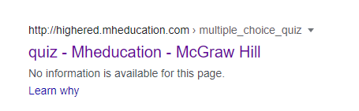

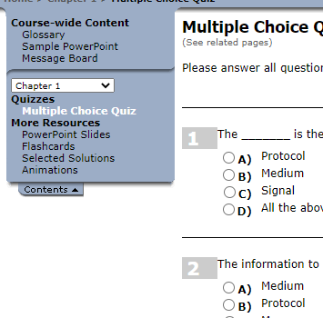
Links for mcq
Link for books mcq
http://highered.mheducation.com/sites/0072967757/student_view0/chapter1/multiple_choice_quiz.html
From the above link chose the chapter number and click on Multiple Choice Quiz.
Notes:
In 1993, the size of the routing tables started to outgrow the capacity of routers
Consequence: The Class-based assignment of IP addresses had to be abandoned

Slide 60


See you in next class

